Slide 1
Integration New Homepage
July 2016
By Pongpayak Boontaetae

Slide 2
Agenda
Introduction
Background
Goal & Design Concept
Web Statistics
Mockups Design
Feedbacks
Timeline

Slide 3
Introduction
Name: Pongpayak Boontaetae
Nickname: Nus
Education: 3rd year Computer Engineering, KMITL
Scope during internship
Improve Integration Team Site based on UCD
xxx
Expectations
Opportunity to experience SAP application in large firms
Interests: Data mining, Artificial Intelligence, Embedded System
รูป

Slide 4
Background
Feedback received from UCD sessions
Difficult to find the documents
Difficult to find the menus
Main menus have no priority
Spending many clicks to get what they need
Low performance of Search Engine

Slide 5
Goal & Design Concept
Goal
Improve the user interface
Improve document search engine
Correct content information & clean up documents
Design Concept
Simple page
Easy to search documents
Portal page (All main functions in a page)

Slide 6
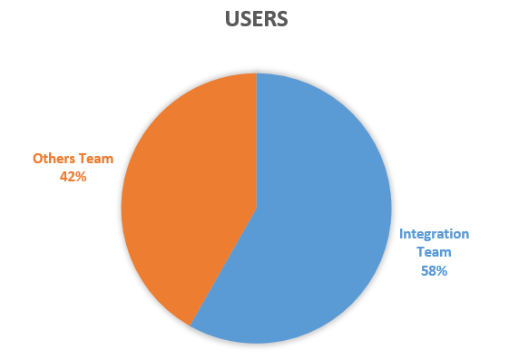
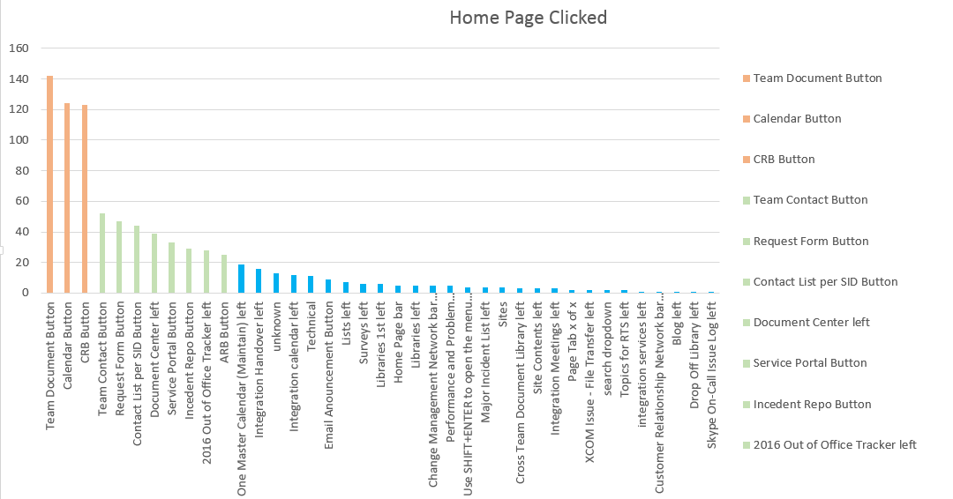
Web Statistics
2 web pages have been enabled to record the clicks (Home and Request Form)
Top Clicks: Team Document Button, SAP Calendar, CRB Repository
58% is Integration users
* From 16 Jun – 6 Jul

Slide 7
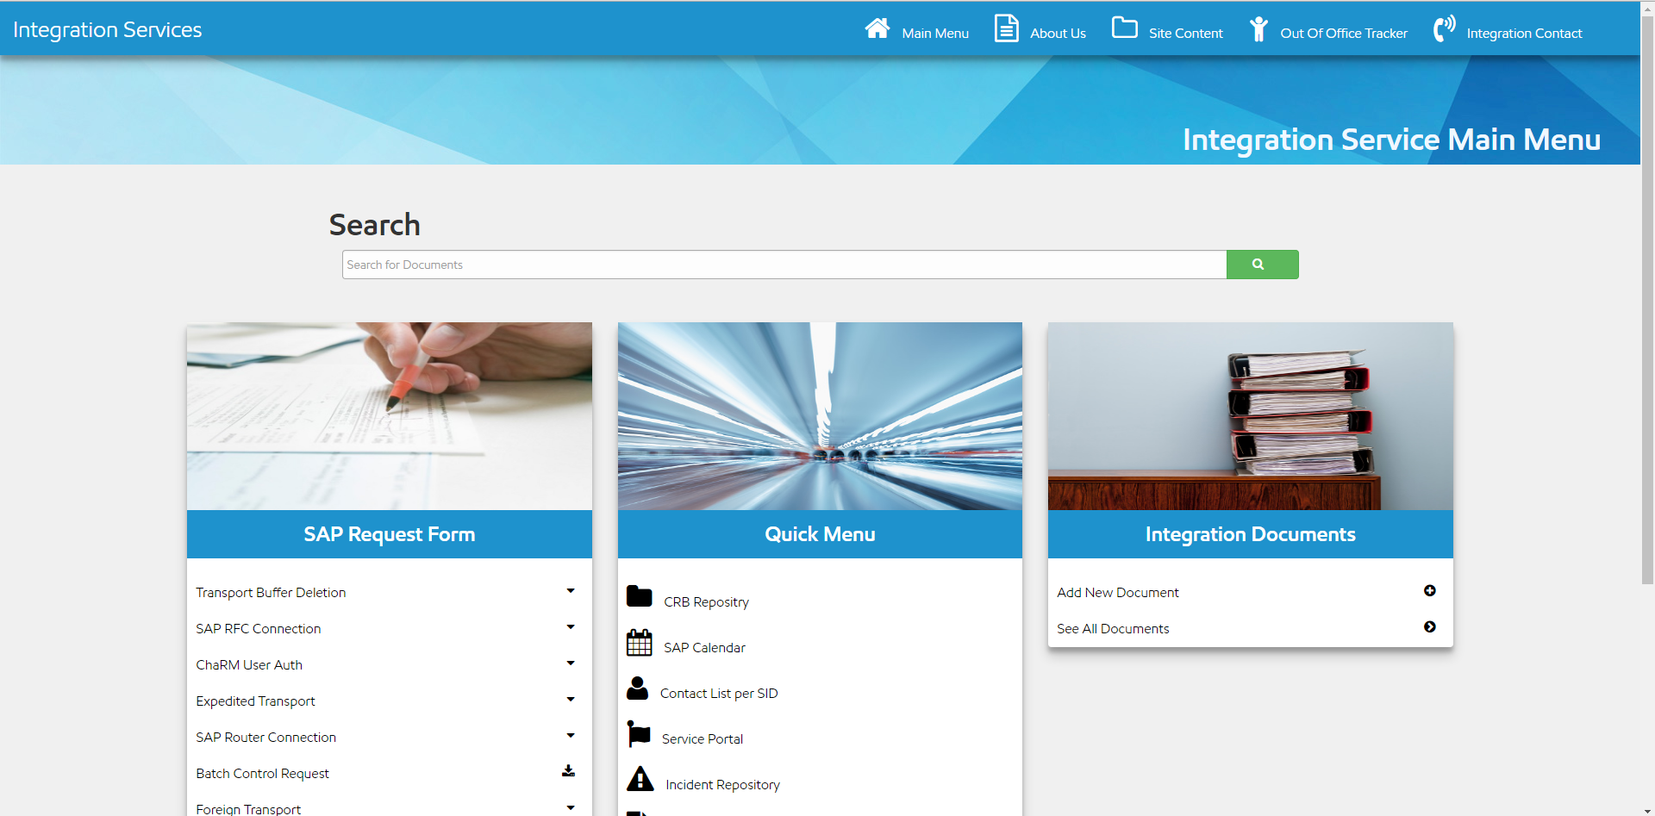
New Home Page
Notes:
Aligned with Service Portal theme
Take web stat into consideration and frequent used buttons are placed
SAP form – sequence by most frequently used
Quick links – other frequently used by users
Team Documents – easy for Integration members to upload documents at home page

Slide 8
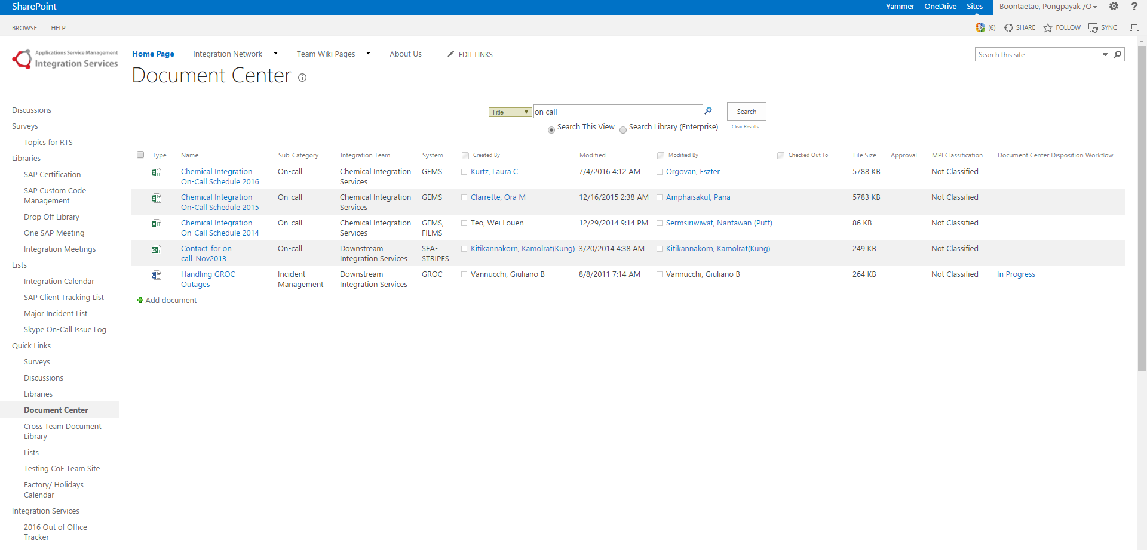
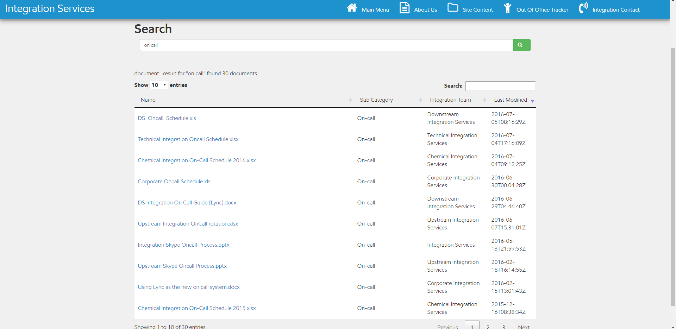
Improve Document Search

Slide 9
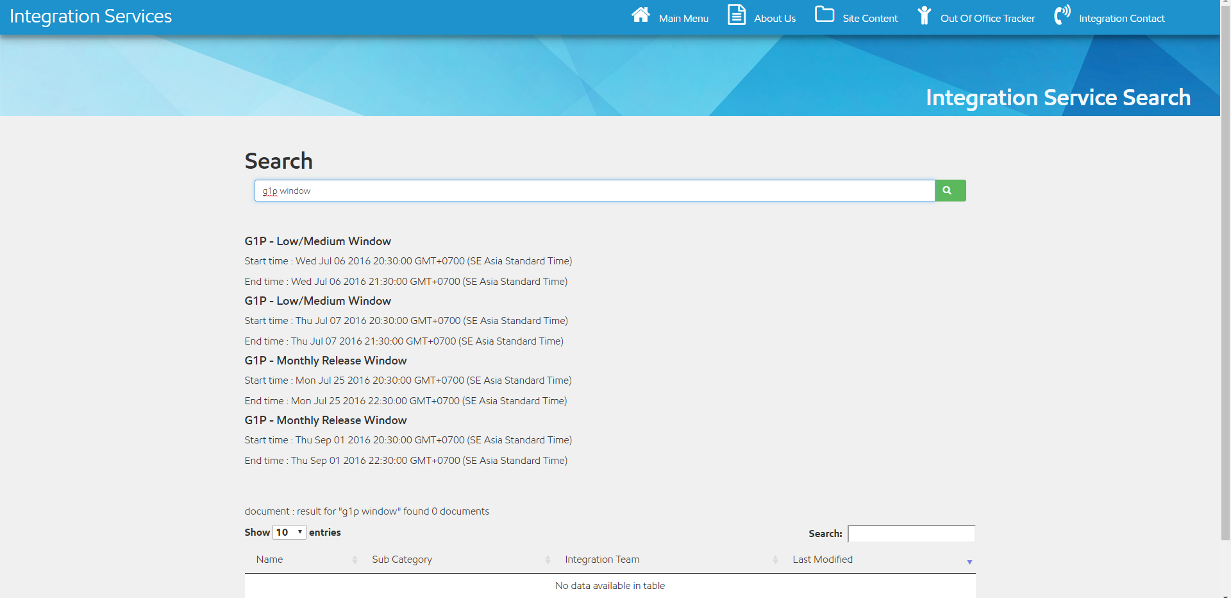
New Transport Window Search
Put in new Search function, utilizing same Search field for document search
Use simply keyword “[SID] Window” i.e. G1P window and function will display next available transport windows
Data is retrieved from the same input used for SAP One Master Calendar, no extra maintenance
* Not final version
Notes:
Develop search engine to provide most frequent questions to users
Provide next available transport windows (2 low/med & 2 monthly) by input simple text – SID + window
The data is retrieved from the same input used for SAP One Master Calendar

Slide 10
Feed Backs!

Slide 11
Timeline
Completed
Pain Point
Web Statistic Collection
Mockups Design
Next Step
Gather Feedbacks from Integration Team
Gather Feedbacks from Process Team
Recycle per Comment
Next Presentation to Leadership Team
Launch New Webpage

Slide 12
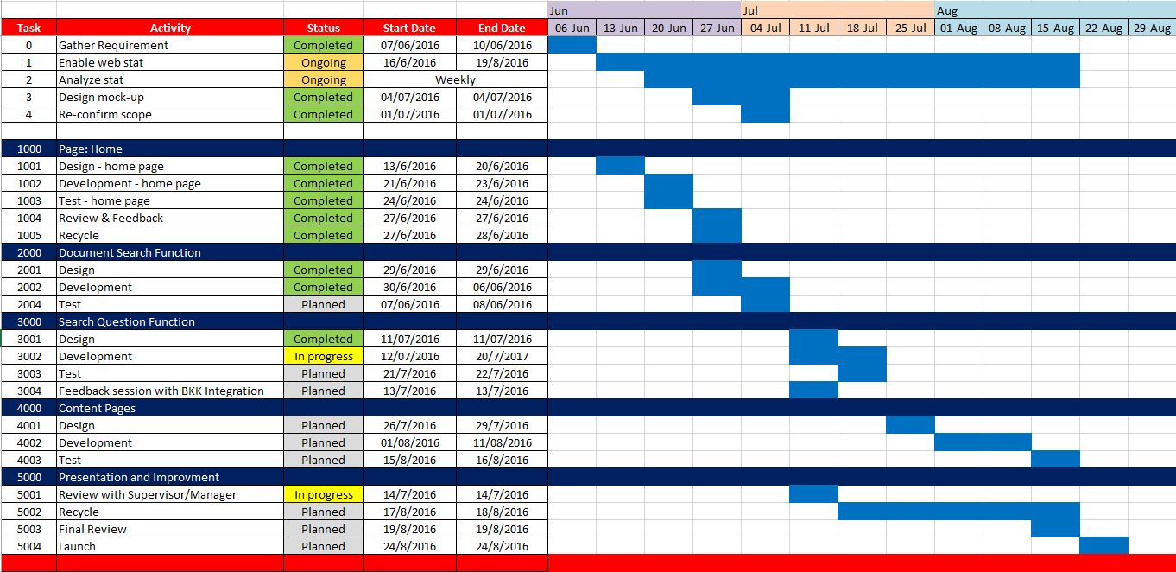
Timeline
Enabled web stat to collect clicks, data is analyzed on weekly basis
Home page site development has been completed and ready for review
Improved functions are being developed & under unit testing phase, session to get feedback from Bangkok team has been planned
Plan to publish new site by end of Aug, included recycle with other Integration members
Notes:
Study requirement for the first few weeks?
Decided to enable web trends to capture the data – when?
Plan for internal feedback

Slide 14
References

Slide 15
References
Task Schedule - https://mysite.na.xom.com/personal/ap_pboonta/_layouts/15/WopiFrame2.aspx?sourcedoc=/personal/ap_pboonta/Documents/Shared%20with%20Everyone/task%20schedule.xlsx&action=default
New Homepage - https://ishareteam3.na.xom.com/sites/SASInt/intpro/index.html
Home page Statistic - https://ishareteam3.na.xom.com/sites/SASInt/Lists/Web%20stat%20Homepage/AllItems.aspx
Form Request Statistic - https://ishareteam3.na.xom.com/sites/SASInt/Lists/Web%20stat%20Form%20Requests/AllItems.aspx

